Slide 1



The Abortion and Reproductive Justices
Pre- Conference Session
Thailand, February 2024
The Harm Reduction Model
Skills Building
Cecilia Stapff
Iniciativas Sanitarias
URUGUAY

Slide 2

Uruguay 2001
Population: 3.3 million
Maternal Mortality: 23 / 100,000 live
births
Abortion penalized by law since 1938.
Exceptions:
Preserve life of the woman
Rape
Extreme poverty
Unsafe Abortion was the leading
cause of maternal mortality.
FÒS FEMINISTA | MEXICO
Notes:
THE MAIN CHALLENGE REGARDING NATIONAL AND REGIONAL
“MATERNAL HEALTH” IS MORTALITY AND MORBIDITY
CAUSED BY UNSAFE ABORTION

Slide 3
Some Key Points
Making abortion illegal does not reduce nor eliminate its occurrence rather it forces individuals to seek clandestine services thereby risking the health and life.
The harm reduction model is a successful evidenced based approach towards addressing unsafe abortion.
It is not a solution towards access to safe abortion but can create conditions to advance legal abortion.
Advocacy is still required to ensure access to safe and legal abortion while implementing the model.
We recognize that there may be initiatives you are conducting to ensure access to safe abortion (maybe not legal or/and formal) however the harm reduction approach ensures the legal safety of health care providers.
FÒS FEMINISTA | MEXICO
Notes:
THE MAIN CHALLENGE REGARDING NATIONAL AND REGIONAL
“MATERNAL HEALTH” IS MORTALITY AND MORBIDITY
CAUSED BY UNSAFE ABORTION

Slide 4

Iniciativas Sanitarias
In 2001, an NGO set up by health
professionals, Iniciativas Sanitarias (Health Initiatives)
developed a program
to decrease
maternal mortality
and morbidity
from unsafe abortion and
incidence of unsafe abortion.
FÒS FEMINISTA | MEXICO

Slide 5
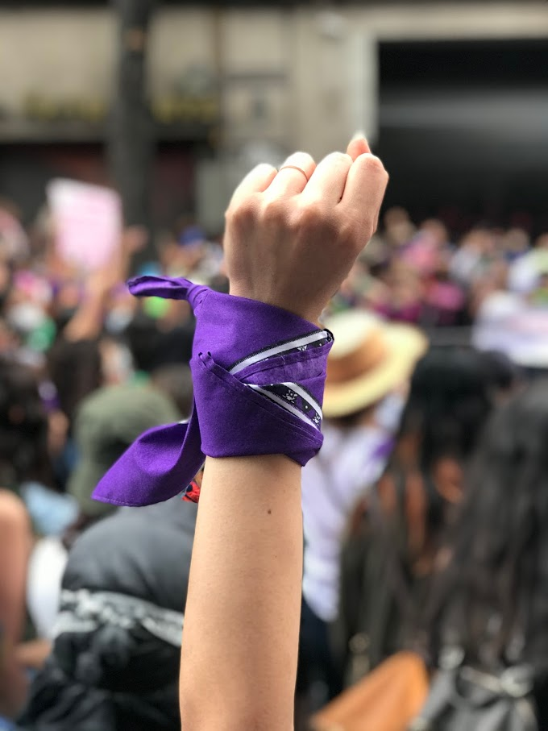
Objectives:
To diminish maternal mortality and morbidity
To decrease the need to have an abortion, and thus, the overall abortion rate
LOLA GUERRA | MEXICO
Strategy:
Risk reduction strategy
Professional values – Bioethics
National Legislation- Laws requiring patient
Confidentiality
Human Rights
Notes:
The harm reduction model is one approach aimed at addressing public health problems.
At the core of HRM, is the recognition that people engage in behaviours that are risky and the intervention can be designed to mitigate the potential dangers and health damages.
It is a philosophical education strategy without moral judgement of the abortion practices.
MODEL focuses on women as the primary decision-makers. Promotes the idea that providing
women with information during an initial consultation ensures that they will be in a better position to
make a decision about their pregnancy, based on their own personal situation, life circumstances, and
values.

Slide 6
New approach:
WOMEN FACING AN UNWANTED PREGNANCY
NEED MULTI-DISCIPLINARY/comprehensive APPROACH:
If
“Sexual and Reproductive Rights” are
“Human Rights”
and
Health-Care assistance is a right too,
then
The National Health System
has an obligation:
to recognize and include not only one
but a range of options that women must be aware of
in order to make an informed
and conscious decision
FÒS FEMINISTA | MEXICO

Slide 7
LEGISLATION ON
ABORTION:
RIGHTS and PRIVACY
Abortion was illegal in our country
Health professionals cannot act during the abortion process
They can act before and after the abortion
Providing information is not a crime
It is the woman’s right to be advised and assisted in the case of unwanted pregnancy
Assure the woman that everything that is discussed during the visit is CONFIDENTIAL

Slide 8
The Guidelines
Before
Abortion
After
1- Counseling regarding
alternatives to abortion
2- Information about
abortion methods and
risks involved:
empowerment
(including Misoprostol)
3- Epidemiological
analysis
POST-ABORTION CARE
1- Damage Prevention
2- Comprehensive
rehabilitation
3- Future contraception
(Diminishing abortion rate)
ILLEGAL
DENIED
Notes:
THIS MEANS TO HAVE A INITIAL VISIT BY UNWANTED PREGNANCY AND AN AFTER ABORTION VISIT. AT THIS MOMENT WOMAN CAN GET COMPREHENSIVE APPROACH WITH A GYNECOLOGIST OR MIDWIFE AND A PSYCHOLOGIST WORKING TOGHETER.
WE CAN´T HELP HER AT TIME OF ABORTION BUT WE CAN DO IT BEFORE AND AFTER

Slide 9
The Guidelines
Before
Build a good relationship
Legislation on abortion. Rights and Privacy
Pregnancy: confirm, viability and gestational age
Explore the reasons
Request group and Rh
Alternatives to abortion
Advise on methods of high and low risk for pregnancy termination
Time for reflection
Consultation with Ob-gyn/Midwife +
psychologist

Slide 10
The Guidelines
After
Ask the women when and how she terminated the pregnancy
Evaluate clinical signs and symptoms of abortion and its evolution
Detect the presence of complications
Evaluate the psychological impact of the decision
Provide immediate contraception

Slide 11

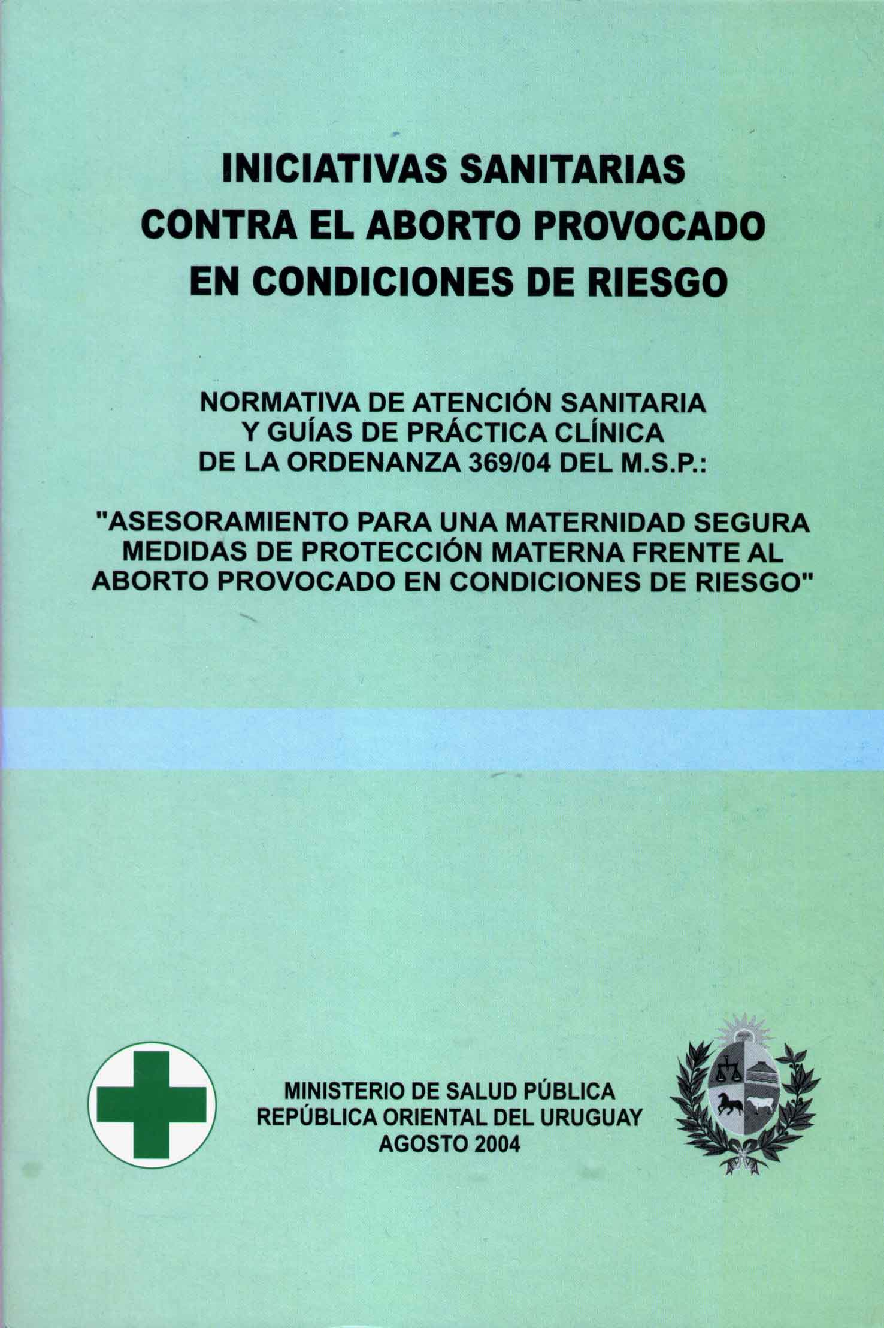

Iniciativas Sanitarias Timeline
2001
2004
2008
2010
2012
Iniciativas
Sanitarias
Ministerial
Ordinance
approval
SRH Law
passed
and guidelines proposed by Iniciativas Sanitarias
IS director deputy minister of health
SRH Law was regulated
SRH Services
MM decreased
The law on voluntary interruption of pregnancy was approved
Publication of the strategy
Partnership with organizations
Hospital care begins
FIGO´S PROJECT
FÒS FEMINISTA SUPPORT TO EXPAND HRM
Notes:
The path followed by Health Initiatives…
We First reached an agreement with different PROFESSIONAL ORGANIZATIONS , WE PUT ALL THE DOCUMENTATION TOGETHER AND PUBLISHED IT.
WE THEN DEVELOPED GUIDELINES ON HOW TO APPROACH AN UNWANTED PREGNANCY AND SOUGHT THE APPROVAL OF THE MINISTRY OF HEALTH
IN 2008 THE SEXUAL AND REPRODUCTIVE HEALTH LAW THAT WAS PASSED INCLUDED OUR STRATEGY.
OUR FORMER DIRECTOR WAS APPOINTED AS VICE MINISTER OF HEALTH
THIS HELPED PAVE THE WAY TO BE ABLE TO PUT THESE HEALTH POLICES INTO PRACTICE
IT IS NOW MANDATORY BY LAW TO IMPLEMENT COMPREHENSIVE HEALTH SERVICES THROUGHOUT THE COUNTRY
FIGO Project: TO SUPPORT THE MINISTRY OF HEALTH IN THE IMPLEMENTATION OF THE SAFE ABORTION MODEL IN 9 HEALTH CARE CENTERS

Slide 12
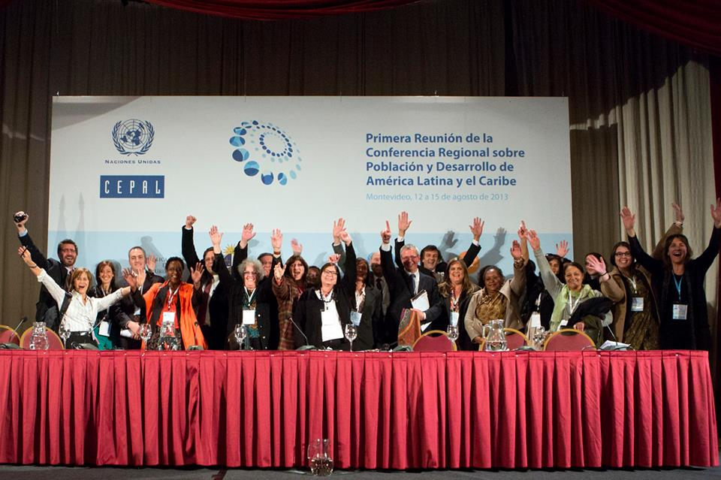
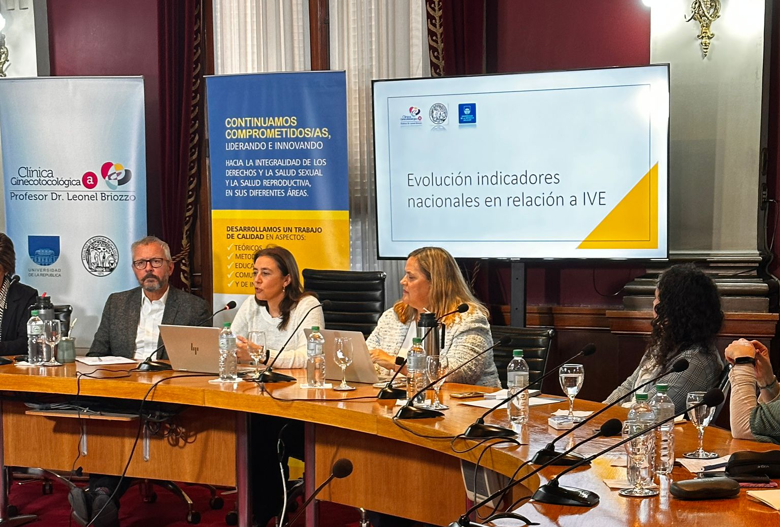
Timeline
Safe abortion in all the Heath System
Lowest abortion rate in LAC
MM per total abortion at low values
2013
2023
Montevideo
Consensus
Implementation
Abortion
Law
IS train Health teams
10 years implementing the Law on voluntary interruption of pregnancy

Slide 13
The Abortion and Reproductive Justices
Pre- Conference Session
Thailand, February 2024
Advocacy in
Harm Reduction Model
Cecilia Stapff
Iniciativas Sanitarias
URUGUAY

Slide 14
Two main slogans:
As we discuss and contribute to legal changes: we must decrease the risks and harms
To decrease the number of abortions :
CSE
contraception
safe access
LOLA GUERRA | MEXICO

Slide 15
The framework of the model emphasizes
Although we continue to push for the legalization of abortion, it is not necessary to implement the program
It only needs:
  A committed, comprehensive/multidisciplinary Health care team
  Adequacy of Health care system
  Public opinion dissemination

Slide 16
PUBLIC SEPEECH
Where we started from:
This is not just any sexuality issue
This is not just another controversial topic
This topic is the topic of life: "dilemma”: begin and end

Slide 17
Unsafe abortion is a health problem
Justice and equity issue
Gender and rights issue
Breaking the dichotomy "for" vs. "against" and enabling independent engagement of judgment on abortion.
Taking the first step in changing the health relationship
From the current regulatory framework and in the direction of change
Restrictive laws: opportunity for change.
Public
Speech
KEYS:

Slide 18

Social mobilization in LAC:
Feminist movement
Committed health professionals
Academia
Social organizations
Community
“Green wave”
Hot lines
LOLA GUERRA | MEXICO

Slide 19
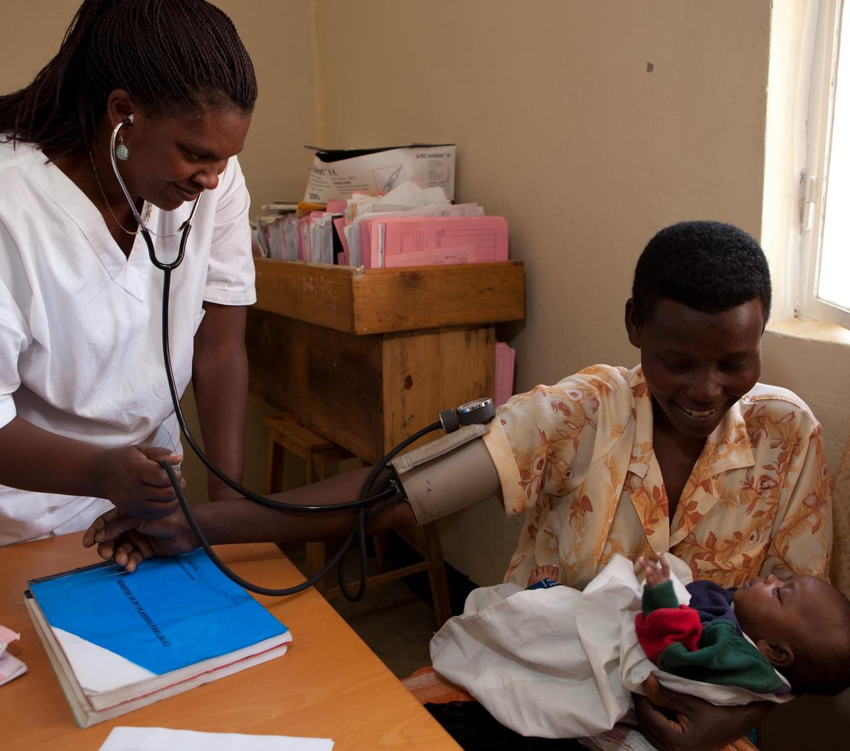
Advocacy in East Africa:
Committed health professionals.
Academia through the Tanzania Health Summits and medical journal publications.
Meetings with key decision makers at the Ministry of Health.
This Photo by Unknown Author is licensed under CC BY-SA-NC

Slide 20
Lessons Learnt
Multidisciplinary team
Original idea - professional strategy
Join professional organizations
Evaluate and share results and evidence
Provide law projects foundations
Public Positioning
Change health relationship and ensure human rights
HRM creates the conditions to move towards legal abortion
FÒS FEMINISTA | MEXICO

Slide 21
Being part of the solution..
THANK YOU!

